Slide 1
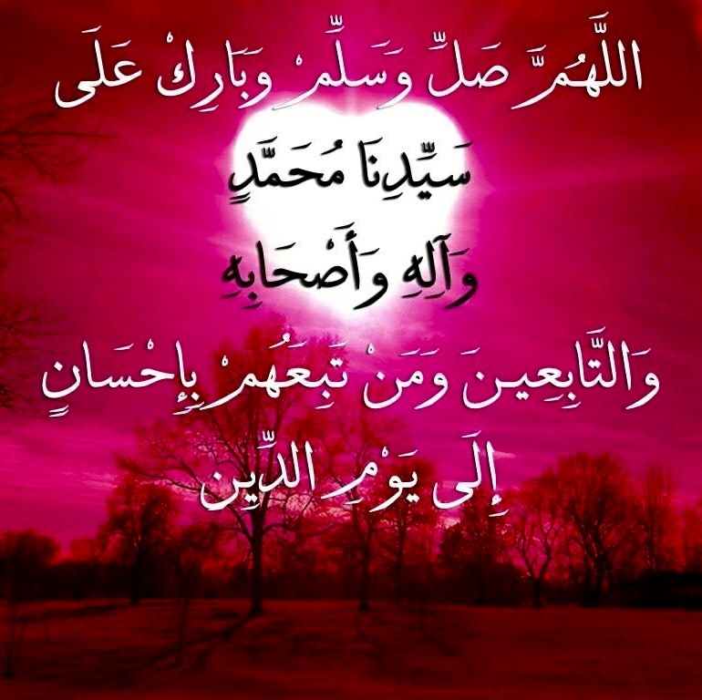


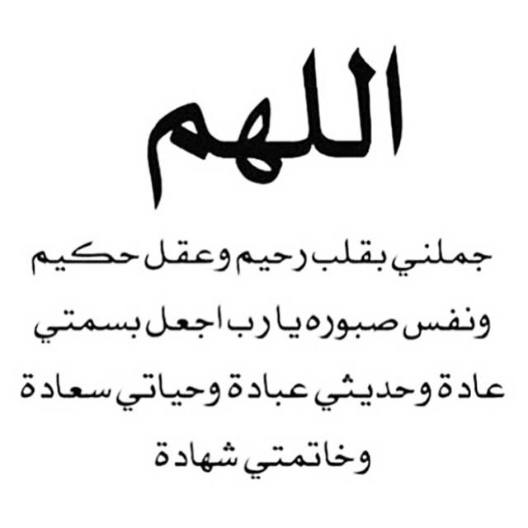

Slide 2
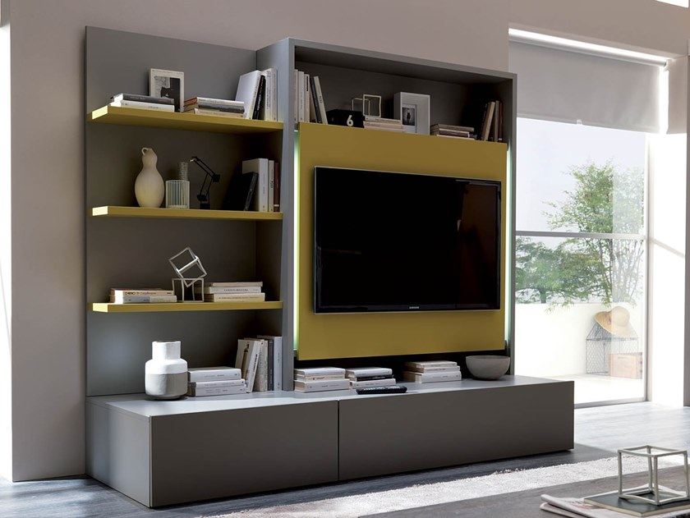
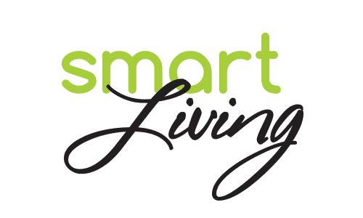
Unit 7

Slide 3
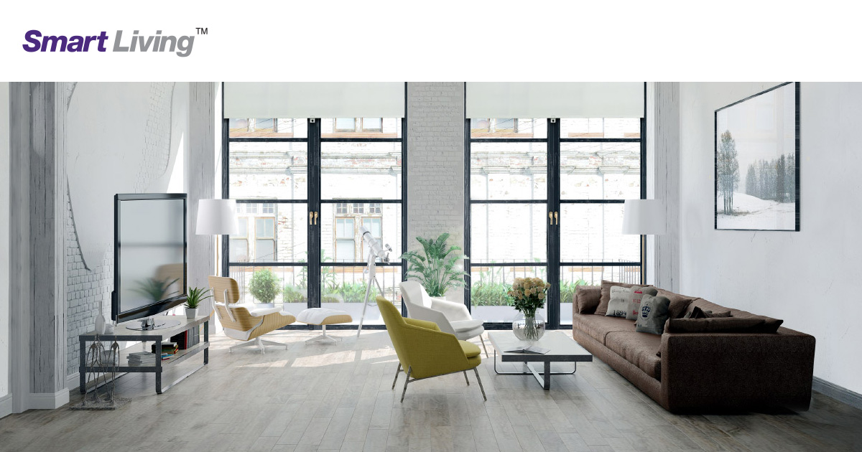

Slide 4

Opener

Slide 5
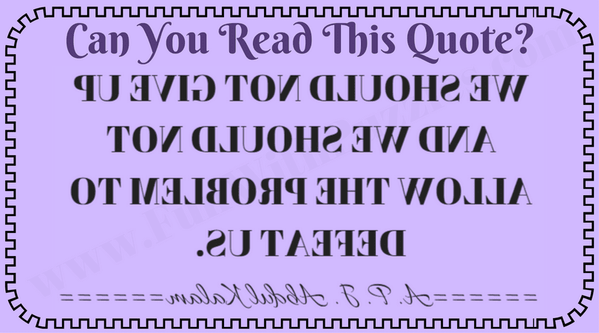

Slide 6

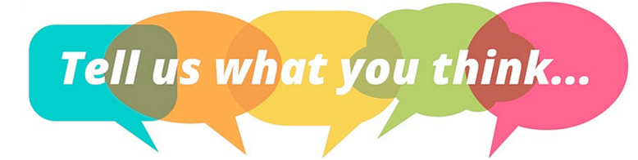
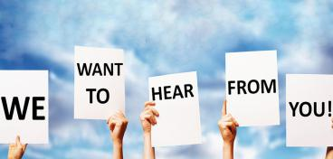


Slide 7
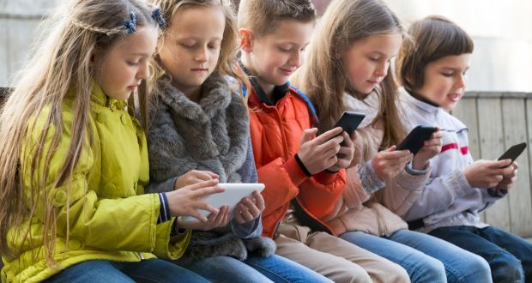
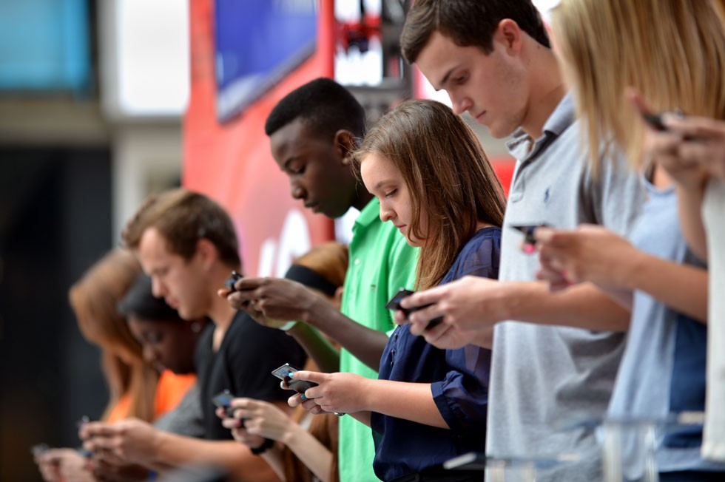
Are you addicted to your smart phone?

Slide 8
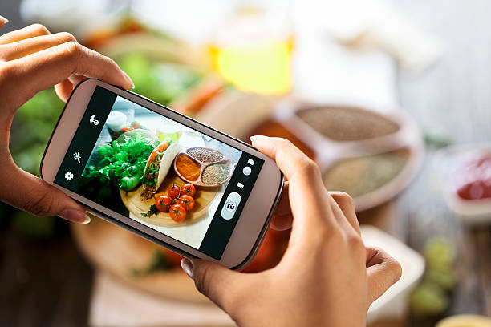
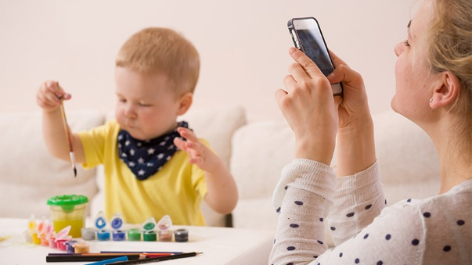
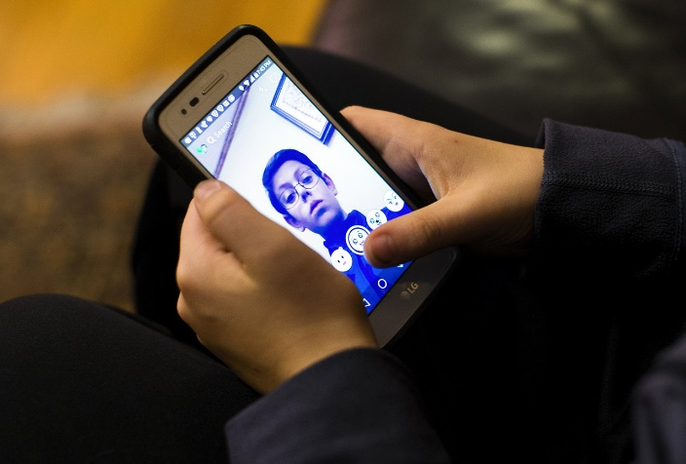
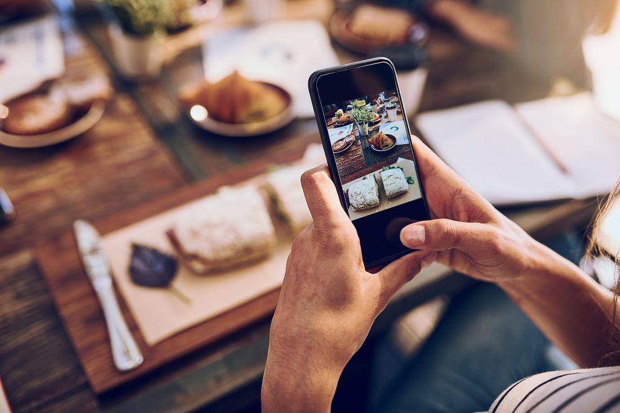
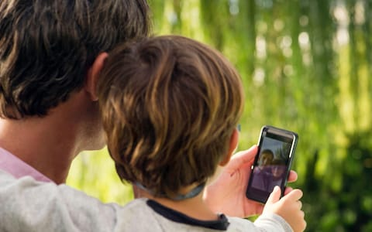
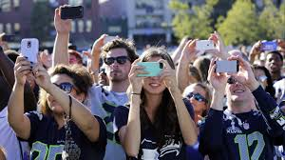
How many images do you post a day?

Slide 9
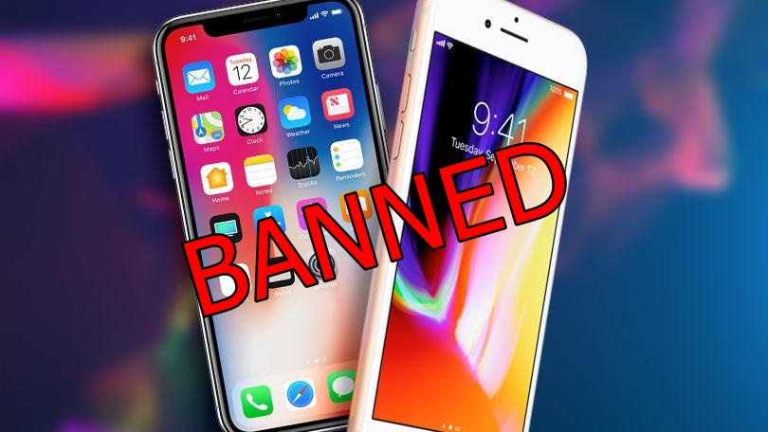
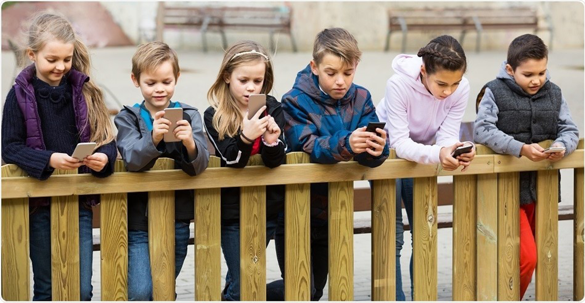
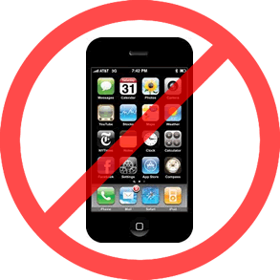
What would you do if your parents ban you from using your smart phone?

Slide 10
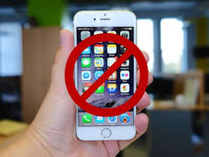
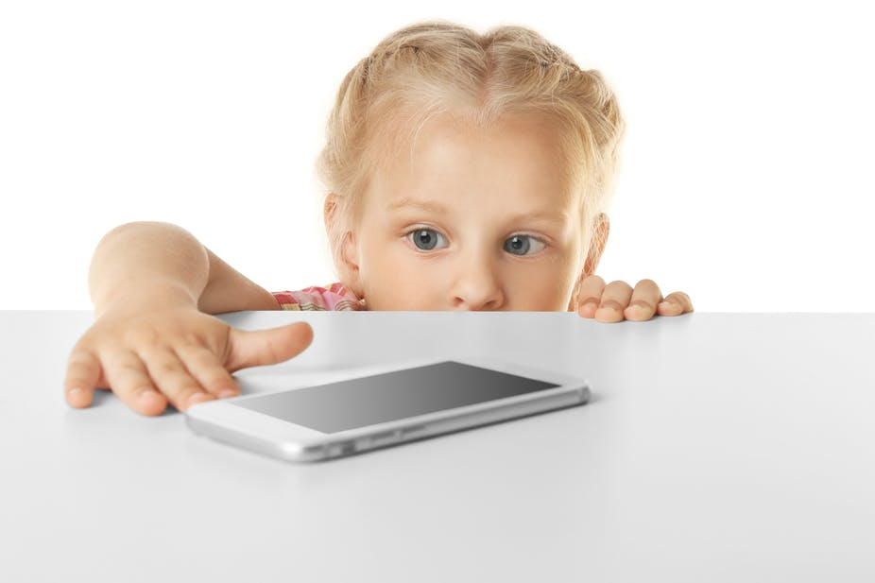


ban
refuse to allow

Slide 11
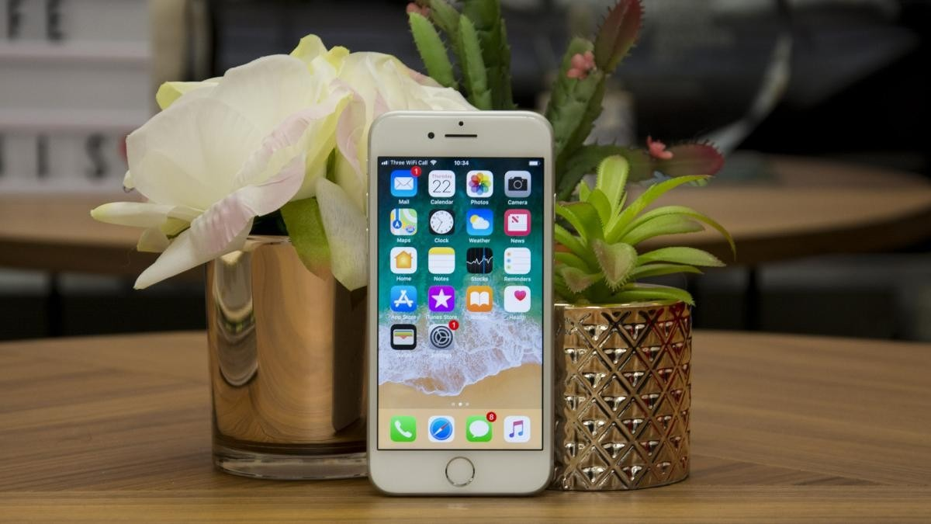

Many people think that their smart phones are worth a fortune to them.

Slide 12
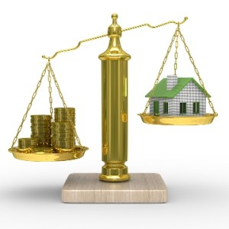
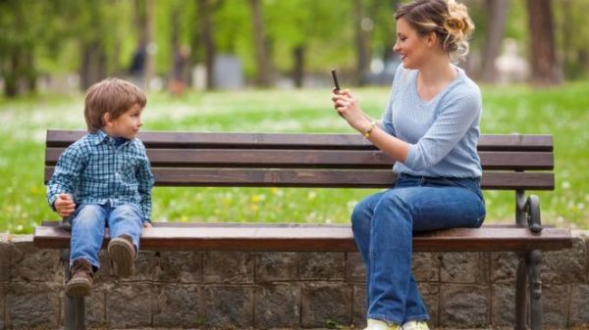
worth
having a particular value, especially in money

Slide 13
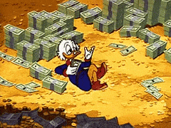
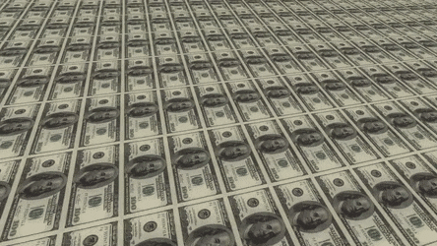
fortune
wealth; a large amount of money

Slide 14
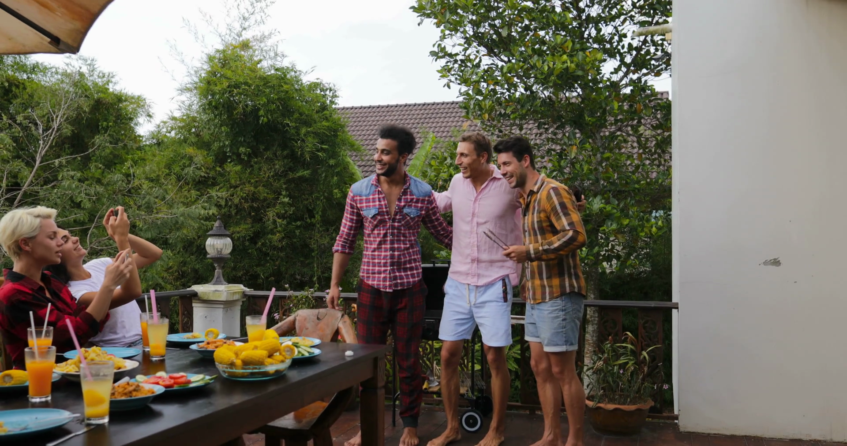
The best of times are always found
when friends and family gather around.

Slide 15
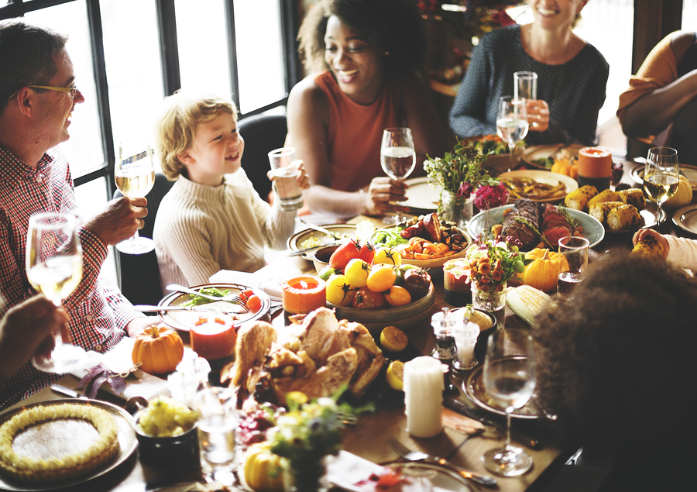
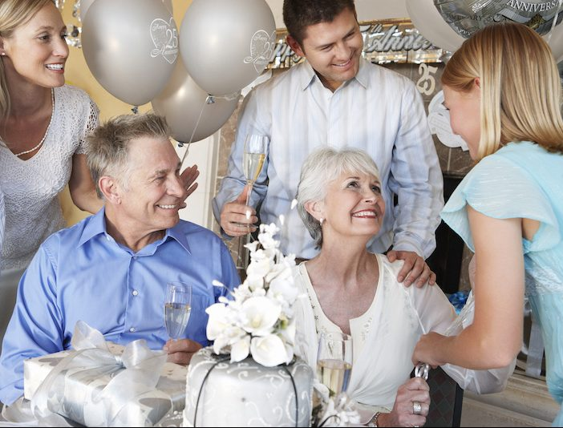
gather
to come together in a group

Slide 16
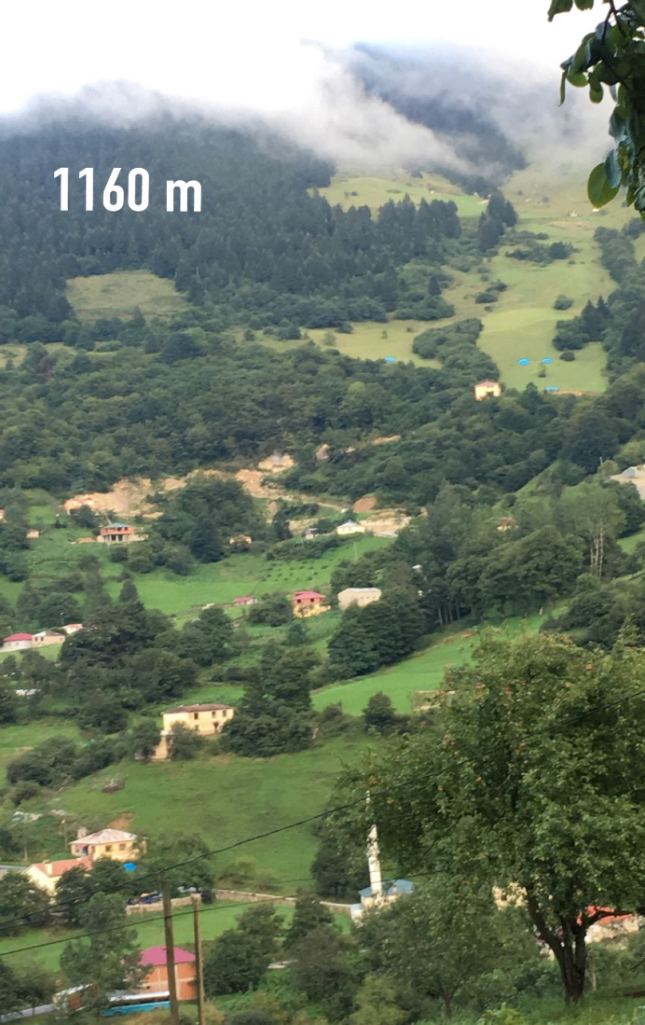
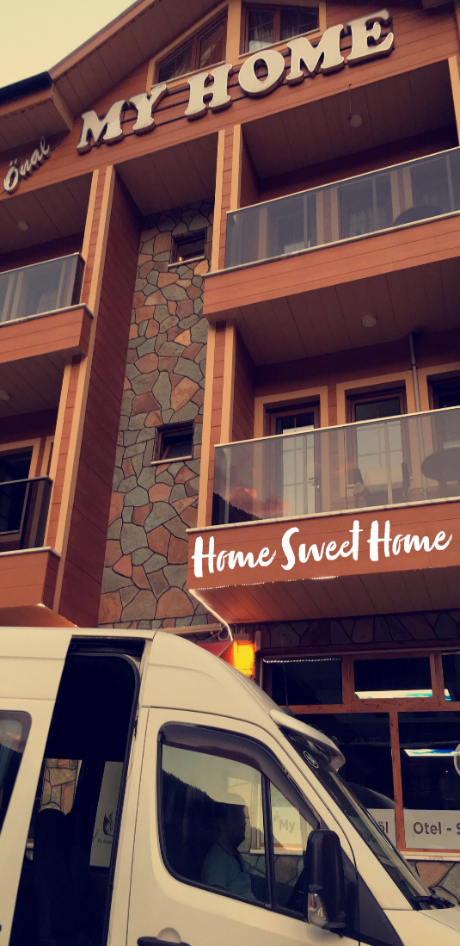
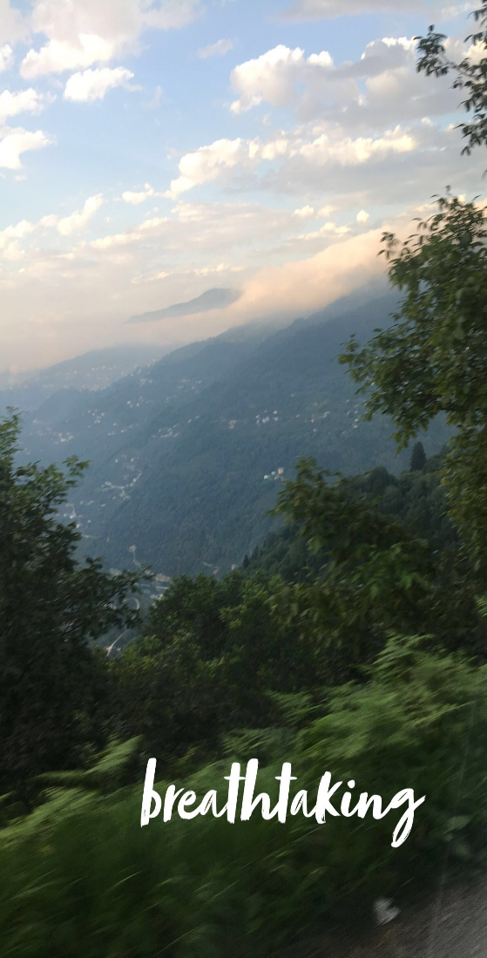
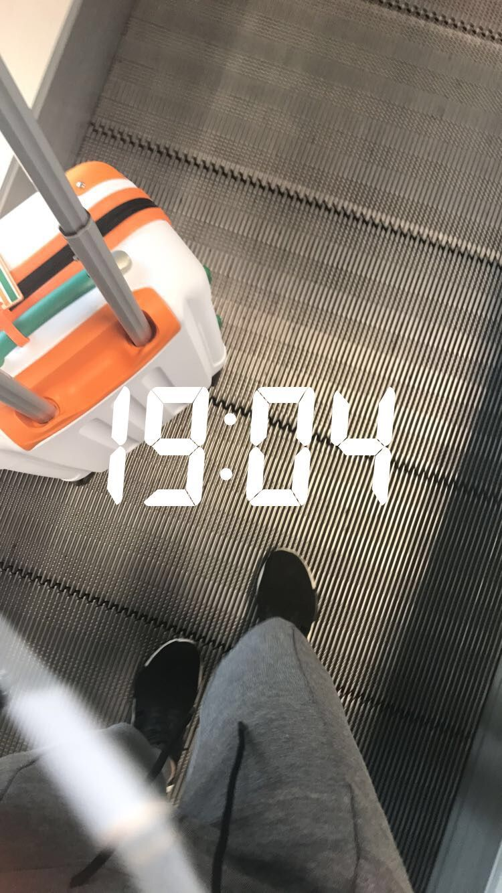
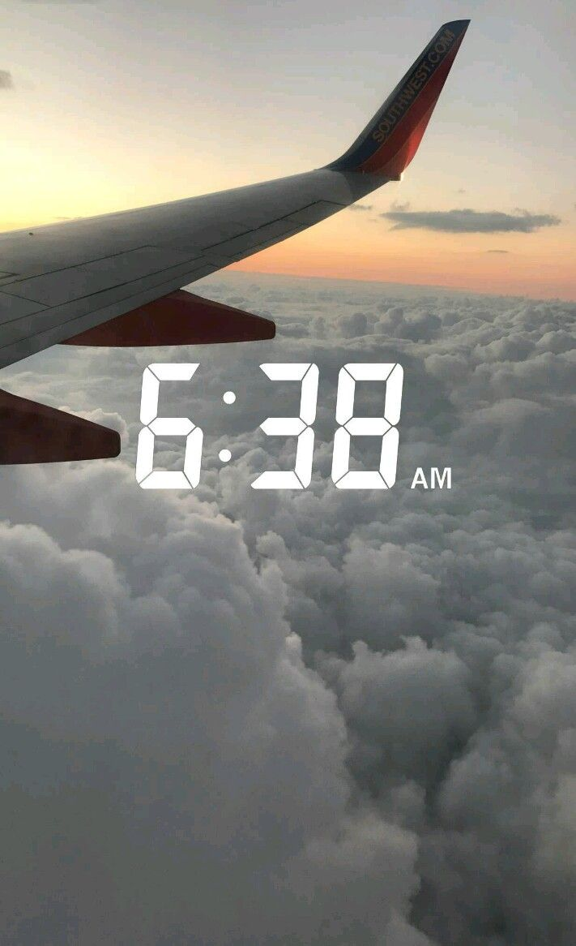
People like to recount their memories and adventures on Snapchat and Instagram.

Slide 17
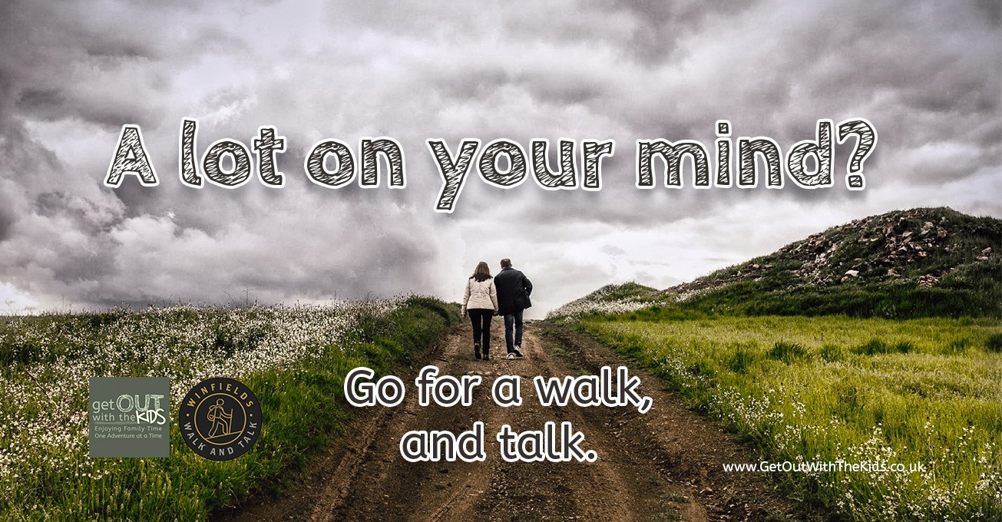
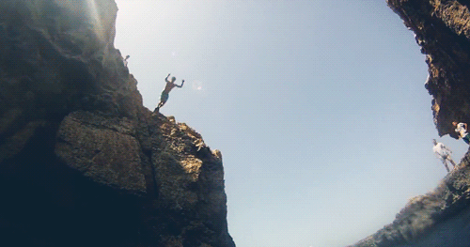
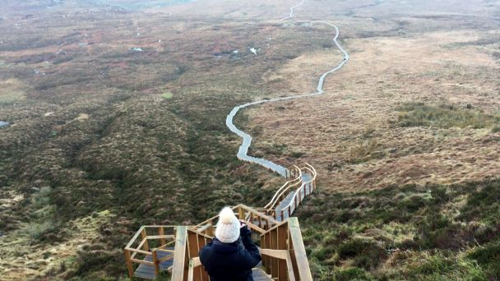

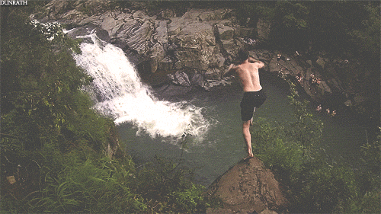
recount
to describe how something happened, or to tell a story

Slide 18
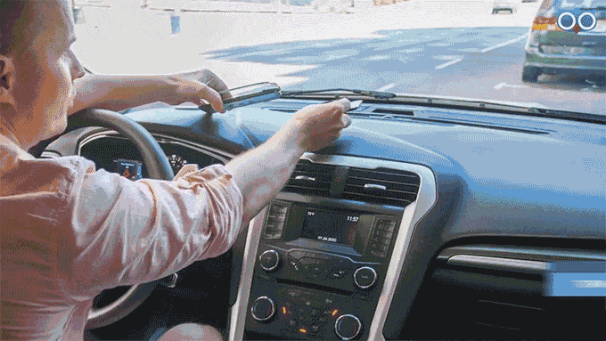
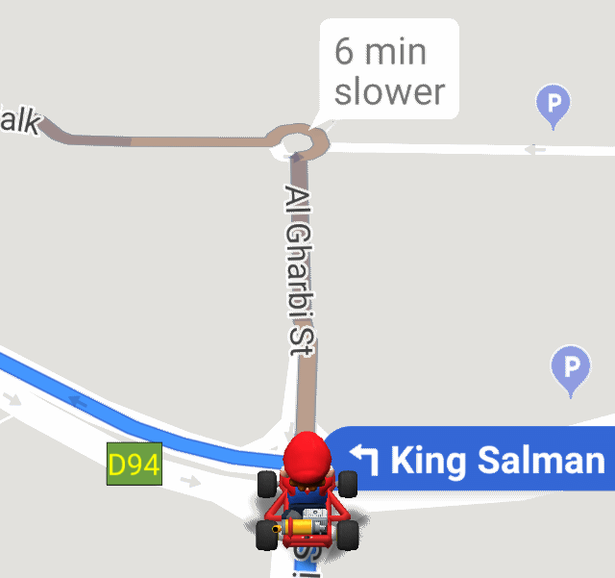
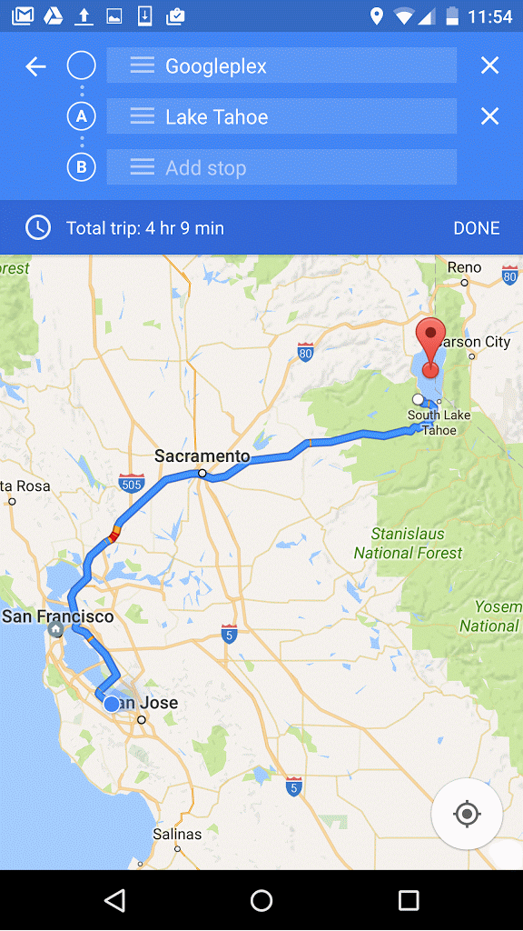
You can looked up the directions on your Maps application to find your way.

Slide 19
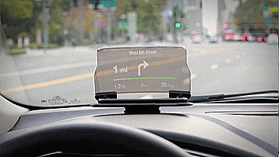
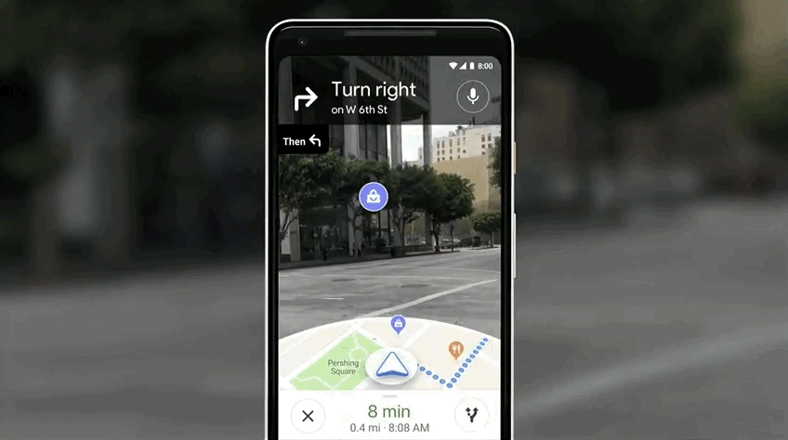
application
a computer program that is designed for a particular purpose

Slide 20
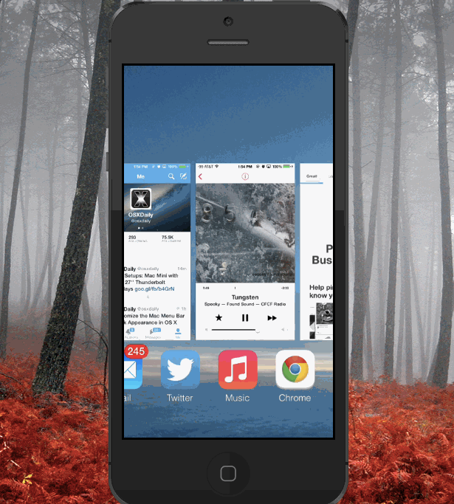
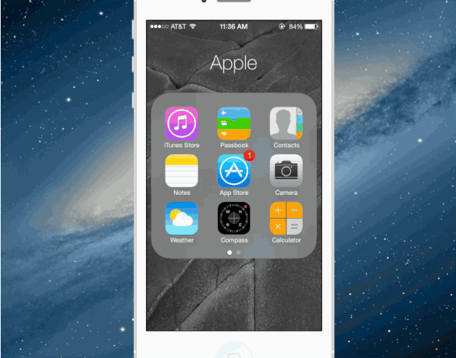
Many smart phones are really handy.

Slide 21
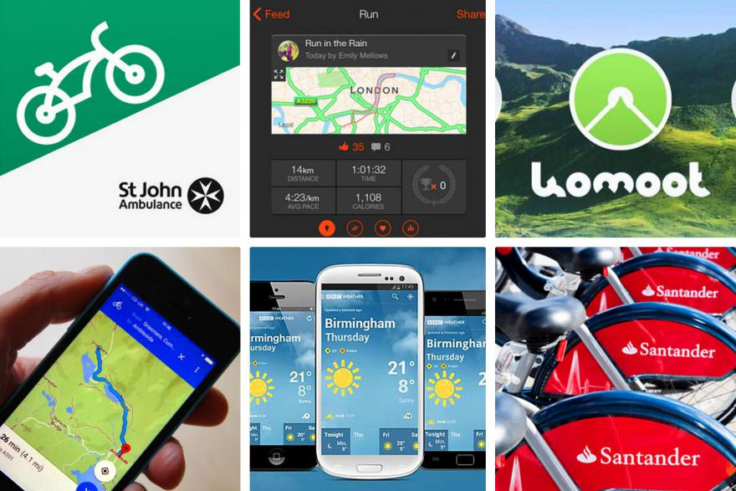
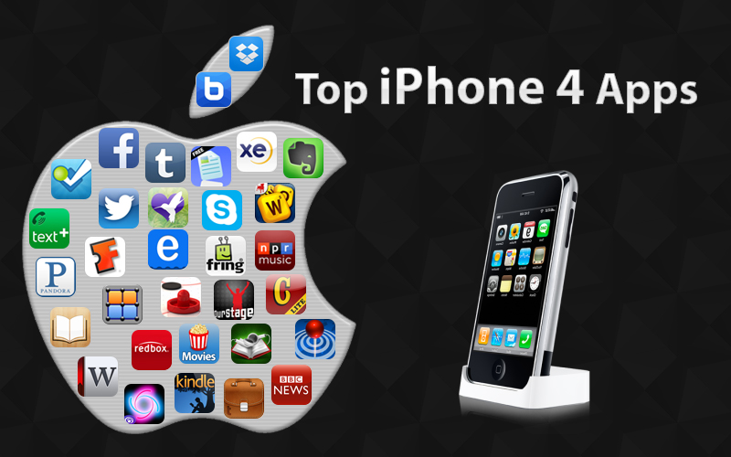
handy
useful

Slide 22

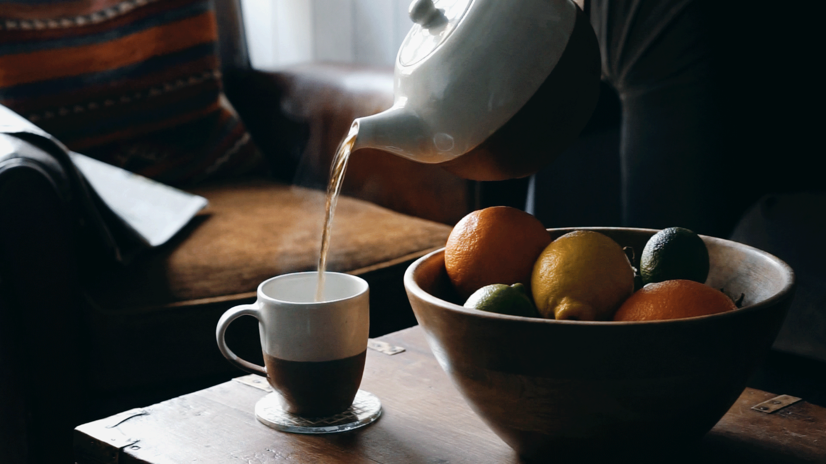


Slide 23

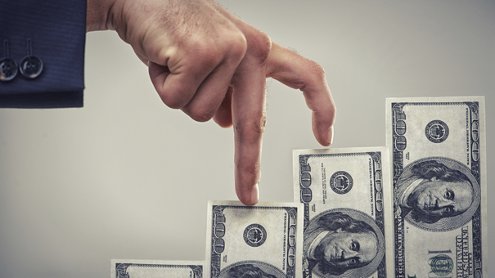
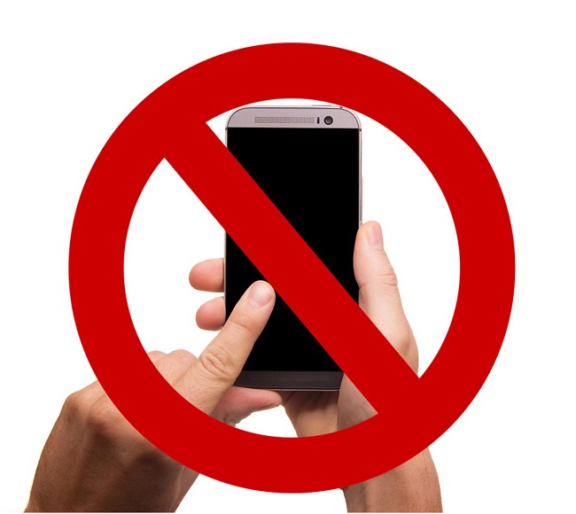






ban (v.)
worth (adj.)
fortune (n.)
gather (v.)
recount (v.)
application (n.)
handy (adj.)

Slide 24

Student’s Book
Page 61

Slide 25



Slide 26




Slide 27

Read your answers.

Slide 28


Do you think mobile phones are a good invention? Why?

Slide 29



Are there any places where you think mobile phones should be banned? Why?

Slide 30



Slide 31


Slide 32


A radio station recently asked its listeners for their points of view about smartphones.

Slide 33

This is what some of them said.

Slide 34



Slide 35

Read your answers.

Slide 36
Read and sum up what each of the following
persons thinks of mobile phones in one sentence.
Smart phones become a main part of our daily lives.
Smart phones have harmful effects on our health.
Smart devices are very handy in many situations.

Slide 37



Slide 38
Omar
“I can’t live without my smartphone. I think I’m addicted to it. In fact, I post over ten images a day and send at least thirty text messages. I just like to be in touch with all my friends. I wouldn’t give it up for all the money in the world, it’s worth a fortune to me.”

Slide 39
Mariam
“I have a mobile, but I try not to use it excessively. I worry about its harmful effects on my health. I read that a lot of studies suggest a possible link between frequent headaches and smartphones. I always keep it away from my children.”

Slide 40
Jaber
“I think smartphones, tablets and computers have a very bad effect on people. They seem to be stuck to those devices all the time. I miss the old days when grandparents and grandchildren gathered to recount their favourite memories and family history.”

Slide 41
Jassim
“I think they’re really useful. It’s great to be able to call or text an employee for an important meeting. The other day my car broke down on the highway and it was great to be able to phone for help. Another time, I got lost on the way to a friend’s house and I just looked up the directions on my Maps application. That was really handy.’’

Slide 42



Slide 43




What is your point view about smart phones?

Slide 44

Closure

Slide 45

What would life be without smart phones?

Slide 46


Slide 47

Thank you

